Slide 1

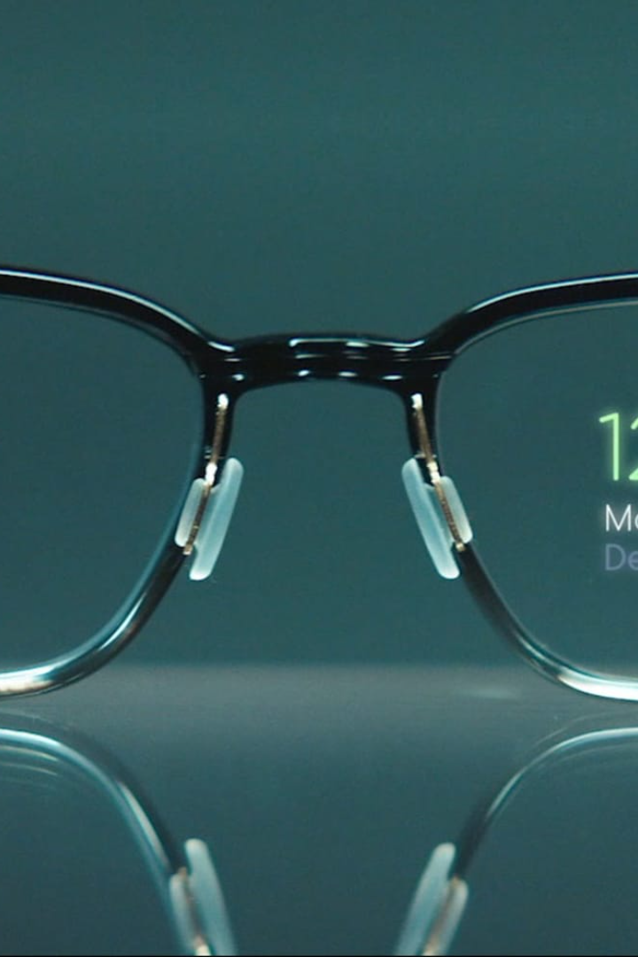
Ai based SmartGlasses
Ai based SmartGlasses are revolutionizing the way we interact with the world. From augmented reality to advanced vision assistance, these innovative wearable devices are pushing the boundaries of technology.
By Shivam Awasare

Slide 2


SmartGlasses
by Meta
Meta has recently introduced a groundbreaking line of smartglasses that are set to revolutionize the way we perceive and interact with the world. With cutting-edge augmented reality capabilities and advanced biometric sensors, by saying “Hey Meta,” you can engage with Meta AI to spark creativity, get information, and control features — just by using your voice.

Slide 3
The Importance of Ai based SmartGlasses
Enhanced Productivity
Improved Accessibility
Immersive Learning
By overlaying digital content onto the real world, these glasses offer immersive educational experiences, transforming the way we learn and absorb information.
With state-of-the-art Ai capabilities, these glasses enable professionals to access real-time information, optimize workflows, and boost productivity.
Ai based SmartGlasses provide visually impaired individuals with enhanced vision, helping them navigate their surroundings more independently.

Slide 4
The Impact of Ai based SmartGlasses
1
Healthcare Advancement
Ai based SmartGlasses are revolutionizing healthcare by enabling surgeons to have real-time access to patient data during surgeries, reducing errors and improving outcomes.
Enhanced Safety & Security
2
By providing instant access to vital information and warnings, Ai based SmartGlasses are improving safety for workers in hazardous environments.
3
Transforming Entertainment
From immersive gaming experiences to immersive movie-watching, Ai based SmartGlasses are revolutionizing the entertainment industry and creating captivating experiences.

Slide 5
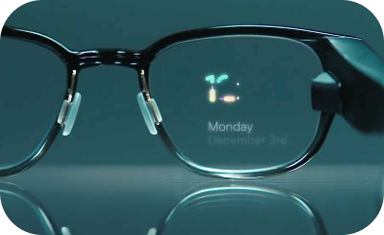
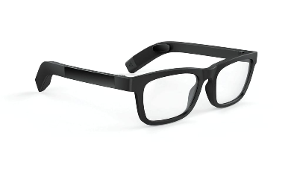
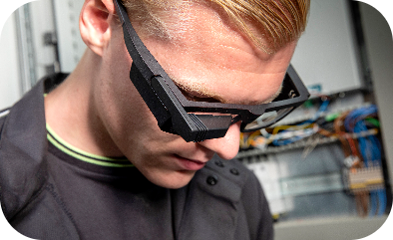
The Future of Ai based SmartGlasses
Seamless Integration
Stylish and Fashionable
Revolutionizing Communication
In the future, Ai based SmartGlasses will seamlessly integrate with our daily lives, acting as an extension of who we are, enhancing our abilities, and connecting us to the digital world.
As technology advances, Ai based SmartGlasses will not only be highly functional but also fashionable, making them a must-have accessory for both tech enthusiasts and fashion-forward individuals.
Imagine a world where conversations are translated in real-time, allowing people from different cultures and languages to communicate effortlessly. This is the future of communication with Ai based SmartGlasses.

